Slide 1
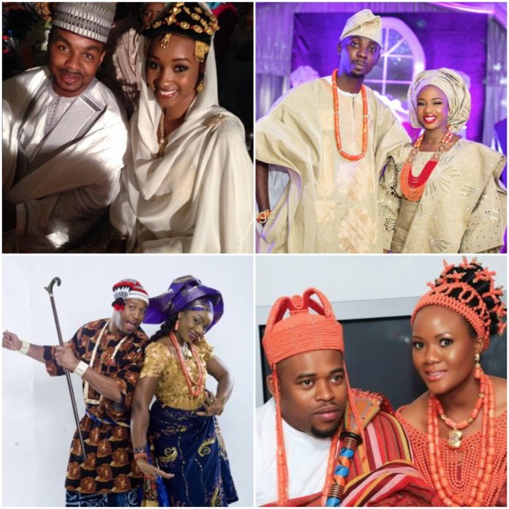
GST 112
NIGERIAN PEOPLES AND CULTURE
Facilitator: Mr. Joseph Eneji
Notes:
Photo source: Google online
THE NATURE OF HUMAN BEINGS - MAN'S FREEDOM

Slide 2

Nuts and Bolts!
No use of laptops & phones during lectures.
There is no bonus mark for agreeing with the lecturer.
Class participation is encouraged.
Submit assignments on or before due date.
Evidence of independent research will count in CAs and final exam.
Those who disturb the class will be sent out of the class.

Slide 3
The scope of the course
Although the course is titled: NIGERIAN PEOPLES AND CULTURE, it also has to do with African cultures and civilizations.
This is because the knowledge of African cultures and civilizations will help the student(s) to better situate the Nigerian culture within the African continent.

Slide 4
Course Objective
The objectives of the course includes:
To help students in different fields of study to understand the past, and present of Nigeria’s cultural heritage so as envision a brighter future in that regard.
To create an African cultural identity imbued with moral and societal values that strengthen human solidarity, national consciousness, and unity.

Slide 5
Expected outcome
At the end of the course, the students are expected to:
Understand African history and culture, and to be able to apply the ideas therefrom to the attainment of technological, political and social development in Nigeria.
Appreciate the cultural heritage of Nigeria especially in its diversity and relevance to the development of the country.
Imbibe good cultural values, and apply/live them out.
Be able tap into the rich prospects of indigenous culture to meet contemporary needs.

Slide 6
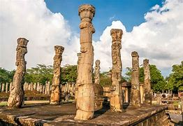
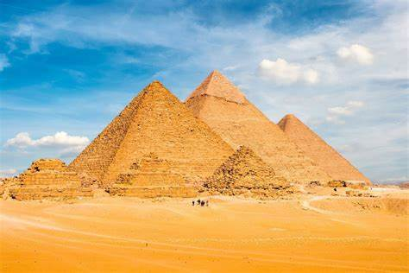
Culture and Civilization in History
Notes:
Source: https://kids.nationalgeographic.com/videos/topic/history-and-culture
THE NATURE OF HUMAN BEINGS - MAN'S FREEDOM

Slide 7
Man as a cultural being (Homo culturalis)
Man is a cultural being in all his psychosocial manifestations: attitudes, beliefs, and values.
These manifestations of culture form a social heritage that is transmitted from past to present through the process of enculturation and instrumentality of social groups.
Notes:
Reference: Ekwuru, G. E. (2010). Basic Introductory Themes in Philosophical Anthropology, Owerri: Living Flames Resources
THE NATURE OF HUMAN BEINGS - MAN'S FREEDOM

Slide 8
What is culture?
Etymologically, culture is from latin verb colere which means to cultivate.
Based on this etymological sense, we thus speak of:
Culture in eliterian sense refers to the acquisition of great quantity of knowledge (hence, we speak of a “cultured” man, or ‘cultural’ formation, and the sophistication of an individual).
Notes:
Elitarian: one who believes that a society or community should be ruled by an elite
THE NATURE OF HUMAN BEINGS - MAN'S FREEDOM

Slide 9
Contd…
Culture in pedagogical sense: Culture in this sense points to the education of the human faculty, or cultivation of human talents.
Culture in anthropological sense: The totality of customs, beliefs, techniques, and values that distinguish a social group, a tribe, a people, a nation.

Slide 10
Defining culture and civilization
Culture is the total way of life of a people whose elements are shared and transmitted by the members of that particular society from one generation to another.
Culture is made up of customs, traditions, beliefs, behavior, dress, language, arts and craft, relationships, attitude to life, technology and institutions.
Culture is associated with human nature and thus is found in every human society.

Slide 11
Universality and particularity of culture
As a human phenomenon, culture is found in every human society –universality of culture.
Particularity of culture refers to the different ways in which varied geographical conditions and historical factors, influence and give rise to different traditions - modes and actions within a circumscribed environment.

Slide 12
Material and immaterial dimensions to culture
Material- buildings, arts and crafts- dyeing, painting, metalwork, sculpture, carving, woodwork, jewelry.
Non-material- language (verbal and non verbal), music, dances, stories, education, law, government.

Slide 13
Culture and civilization
Some scholars hold that culture designates a particular state of stage of civilization (E.g. Greek ‘culture’).
Civilization is the condition of a society and the processes leading to that condition.
Cultural development leads to a civilization.
The example of early man.

Slide 14
Civilization
“An advanced state of human society, in which a high level of culture, science, industry, and government has been reached; those people or nations that have reached such a state; any type of culture, society, etc., of a specific place, time, or group e.g. Greek civilization.”
dictionary.com

Slide 15
Elements of civilization
Stable food supply
Social structures
Government
Consciousness of the Divine
Aesthetic sensitivity
Use of technology
Means of communication
Transportation

Slide 16
Culture, Civilization AND History
History link together culture and civilization.
We want to know what went on before, the change that altered events, ‘why-how-and-by-whom’ the change came, and consequences of the change.
To reflect on these happenings for our own gain.
“Those who fail to learn from history are condemned to live it” George Santayana

Slide 17
Sources of History
Written AND unwritten.
Written- diaries, newspapers, minutes of meeting, letters, reports, legislative acts, books, accounts, etc.
Unwritten- oral tradition, Interviews.
Archeology
Linguistics
Botany

Slide 18
African and History
In 1923 a European scholar A.P. Newton addressed the Royal African Society on the topic Africa and Historical Research.
"Africa had no history before the coming of the Europeans. History only begins when men take to writing. And since Africa had no knowledge of writing, information of African history could be found only in material remains, in language and in primitive culture.“
A.P Newton
How would you critique the claim above?

Slide 19
References
Bako, A. Muhammed, M. Ismaila, Y. & Rufai, A. M (Eds.). (2014). Issues on Nigerian Peoples and Culture. Zaria: ABU Press Limited
Falola, T. & Heaton, M. M. (2008). A History of Nigeria. New York: Cambridge University Press.
Orngu, S. Chris. (2017). Nigeria: History, Peoples and Culture. Abuja: DonAfrique Publishers.

